Slide 1
Gallo & Robinson, LLC
“How to be an effective advocate: with clients, in your workplace, in your community”.
NASW Student Advocacy Training
October 16, 2020

Slide 2
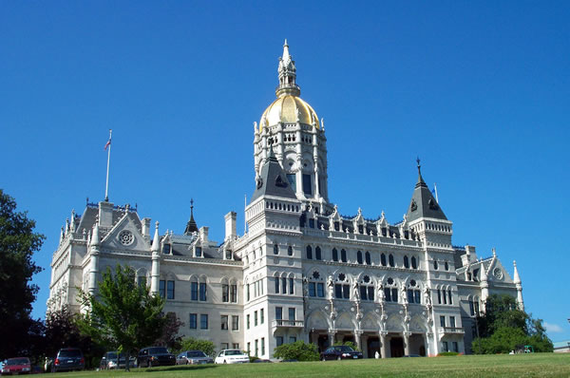
Advocates for Social Justice

Slide 3
What does the word mean?
Noun
Advocacy - active support of an idea or cause etc.; especially the act of pleading or arguing for something
Thesaurus: recommendation, support, defense, championing, backing, proposal, urging, promotion, campaigning for, upholding, encouragement, justification, argument for, advancement, pleading for, propagation, espousal, promulgation, boosterism, spokesmanship

Slide 4
Potential Roles as an Advocate
Identify a problem/Solve a problem
Address an immediate need/seek a solution
Identify barriers and ways to surpass them
Identify a solution and how to implement it
Support or start an effort to make policy changes

Slide 5
Venues where you can use this advocacy training
In personal advocacy with insurance company, healthcare providers, housing, medication, school, condo association, purchase price for products, etc.
At the local level such as transportation, accessible polling places, municipal buildings, passage of a town ordinance you support or oppose, etc.
Working on a campaign to help a certain candidate win.
Legislature (to support or oppose a piece of legislation):
151 members in the House of Representatives
36 Senators
1 Governor
1 Lt. Governor
Congress- to support or oppose a piece of legislation or draw attention to an issue. A single letter can get lost in Congress (while 5 letters from constituents can seem like an entire movement to Legislature or local officials) but there are ways to affect your congressman-a visit to their local office, attending a forum where congressperson is going to be present, participating in a phone-in campaign.

Slide 6
Advocating for clients
Advocating on behalf of a client.
Help them to identify their barriers and solutions.
Help them to tell their story
Document it; this is especially helpful in advocating at the legislature.

Slide 7
Basics of Communications (in all venues, especially policy advocacy).
Identify yourself. | Know your facts. Know your opponent’s facts. | State what you want, at the beginning. | Short!
Clear and always polite. | Personal connection. | Ask the person to support your position. | Ask them to let you know what they are going to do.
Leave a handout. | Follow-up! | Thank you!
Notes:
That’s the “that was EASY” button… but just NEW and IMPROVED… with a check mark.

Slide 8
How to Make Yourself a Better Communicator
Listen carefully
Build a Relationship (with the person you are trying to persuade).
Join with others who care about the issue
Get involved in a campaign
Get active in your community, faith community, etc.
Build a network / power in numbers

Slide 9
Types of Communications
Question: Which method is best?
Answer: ALL OF THEM!
The more personal the interaction, the more effective it is.
Phone Call
Letter
Email
Visit
Action-rally, protest, etc.
Lobby Day
Other (Action Alerts, fax)

Slide 10
Important things to know about a legislative visit
Meet before hand to divide roles
Introduce everyone
Use Basics of Communications (see above)
Think outside the box
Other
Leave Behind Information
Send a Thank-you note

Slide 11
Closing
Questions & Answers

